Slide 1
Lesson: Pointers
CSE 4107 : Structured Programming I
Shahriar Ivan

Slide 2

Pointer Variables
The first step in understanding pointers is visualizing what they represent at the machine level
In most modern computers, main memory is divided into bytes, with each byte capable of storing eight bits of information:
Each byte has a unique address

Slide 3
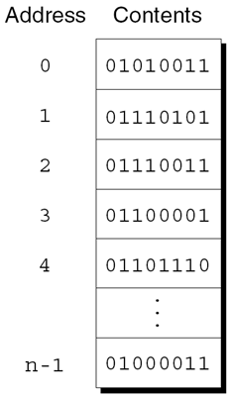
Pointer Variables
If there are n bytes in memory, we can think of addresses as numbers that range from 0 to n – 1:

Slide 4
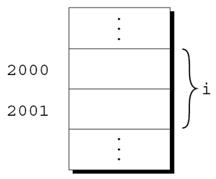
Pointer Variables
Each variable in a program occupies one or more bytes of memory
The address of the first byte is said to be the address of the variable
In the following figure, the address of the variable i is 2000:

Slide 5

Pointer Variables
Addresses can be stored in special pointer variables
When we store the address of a variable i in the pointer variable p, we say that p “points to” i
A graphical representation:

Slide 6
Pointer Variables
Declaration
General form:
type-name *variable-name;
int *p;
Pointer p points to objects of type int
Can appear in declaration with along with other variables
int i, j , a[10], b[20], *p, *q;

Slide 7
Pointer Variables
Declaration
Can point to objects of a particular type
int *p; // points only to integers
double *q; // points only to doubles
char *r; // points only to characters
Two new operators
& (Address) -> Finds the address of a variable
* (Indirection) -> To access the object a pointer points to

Slide 8
The Address and Indirection Operators
The Address Operator
Declaration sets aside space for a pointer, doesn’t make it point to an object
Crucial to initialize before using
int i, *p;
…
p = &i;
Can initialize a pointer variable when declared, also it can be combined
int i;
int *p = &i;
int j, *q = &j;

Slide 9
The Address and Indirection Operators
The Indirection Operator
If p points to i, print the value of i
printf("%d", *p);
Can combine two operators
j = *&i; // same as j=i
When p points to i, *p is an alias for i
*p has the same value as i
Changing *p changes the value of i

Slide 10



The Address and Indirection Operators
p = &i;
i = 1;
printf("%d\n", i); /* prints 1 */
printf("%d\n", *p); /* prints 1 */
*p = 2;
printf("%d\n", i); /* prints 2 */
printf("%d\n", *p); /* prints 2 */

Slide 11
The Address and Indirection Operators
The Indirection Operator
Applying the indirection operator to an uninitialized pointer variable causes undefined behavior:
int *p;
printf("%d", *p); /*** WRONG ***/
Assigning a value to *p is particularly dangerous:
int *p;
*p = 1; /*** WRONG ***/

Slide 12
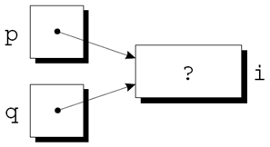
Pointer Assignment
C allows the use of the assignment operator to copy pointers of same type
Assume that the following declaration is in effect:
int i, j, *p, *q;
p = &i;
Another example of pointer assignment:
q = p;
q now points to the same place as p:
Can change i using either *p or *q

Slide 13
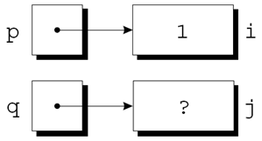
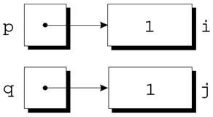
Pointer Assignment
Do not confuse q = p; (Pointer Assignment) with *q = *p;
p = &i;
q = &j;
i = 1;
*q = *p;

Slide 14
Pointers as Arguments
Can be used to modify arguments:
void decompose(double x, long *int_part, double *frac_part){
*int_part = (long) x;
*frac_part = x - *int_part;
}
Possible prototypes:
void decompose(double x, long *int_part, double *frac_part);
void decompose(double, long *, double *);

Slide 15
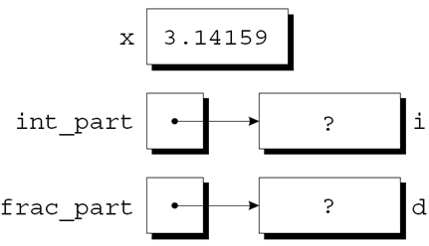
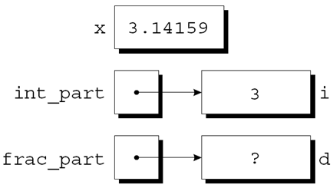
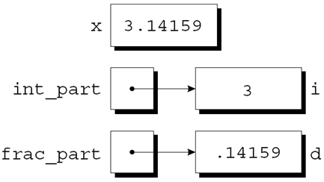
Pointers as Arguments
A call of decompose:
decompose(3.14159, &i, &d);

Slide 16
Pointers as Arguments
Arguments in calls of scanf
int i;
scanf("%d", &i);
without &, scanf only gets the value of i
Every argument doesn’t need &
int i, *p;
p = &i;
scanf("%d", p);
Don’t use & with pointers ⇒ scanf("%d", &p); /*** WRONG ***/

Slide 17
Pointers as Arguments
Failing to pass a pointer to a function when one is expected can have disastrous results
A call of decompose in which the & operator is missing:
decompose(3.14159, i, d);
When decompose stores values in *int_part and *frac_part, it will attempt to change unknown memory locations instead of modifying i and d
If we’ve provided a prototype for decompose, the compiler will detect the error
In the case of scanf, however, failing to pass pointers may go undetected

Slide 18
Programming Tasks
Finding the Largest and Smallest Elements in an Array
The max_min.c program uses a function named max_min to find the largest and smallest elements in an array
Prototype for max_min:
void max_min(int a[], int n, int *max, int *min);
Example call of max_min:
max_min(b, N, &big, &small);

Slide 19
Programming Tasks
Finding the Largest and Smallest Elements in an Array
When max_min finds the largest element in b, it stores the value in big by assigning it to *max
max_min stores the smallest element of b in small by assigning it to *min
max_min.c will read 10 numbers into an array, pass it to the max_min function, and print the results:
Enter 10 numbers: 34 82 49 102 7 94 23 11 50 31
Largest: 102
Smallest: 7

Slide 20
Pointers as Arguments
Using const to Protect Arguments
General assumption ⇒ Pointers as argument will be modified
If not ⇒ Use const
Reason for still passing pointer ⇒ Efficiency
Variable might require a large amount of storage
Waste of time
void f(const int *p){
*p = 0; /*** WRONG ***/
}
Compiler can detect such error

Slide 21
Pointers as Return Values
Functions are allowed to return pointers:
int *max(int *a, int *b){
if (*a > *b)
return a;
else
return b;
}
A call of the max function:
int *p, i, j;
…
p = max(&i, &j);
After the call, p points to either i or j

Slide 22
Pointers as Return Values
A function could also return a pointer to an external variable or to a static local variable
Never return a pointer to an automatic local variable:
int *f(void){
int i;
…
return &i;
}
The variable i won’t exist after f returns

Slide 23
Pointers as Return Values
A function that returns a pointer to the middle element of a, assuming that a has n elements:
int *find_middle(int a[], int n) {
return &a[n/2];
}

